Slide 1


Assignment 2 Portfolio
By Daniel Edwards & Matthew Haydon

Slide 2
Topic Info
MediSecure - recent victim of a ransomware attack.
Breach originated from 3rd party – MoveIt.
The attack is still in progress.

Slide 3
MoveIt
An SQL injection vulnerability had been found in the MOVEit Transfer web application that could allow unauthorised attackers to gain access to MOVEit Transfer's database.
Was then exploited in May and June of 2023.
Versions with vulnerability:
2021.0.6 (13.0.6)
2021.1.4 (13.1.4)
2022.0.4 (14.0.4)
2022.1.5 (14.1.5)
2023.0.1 (15.0.1)

Slide 4

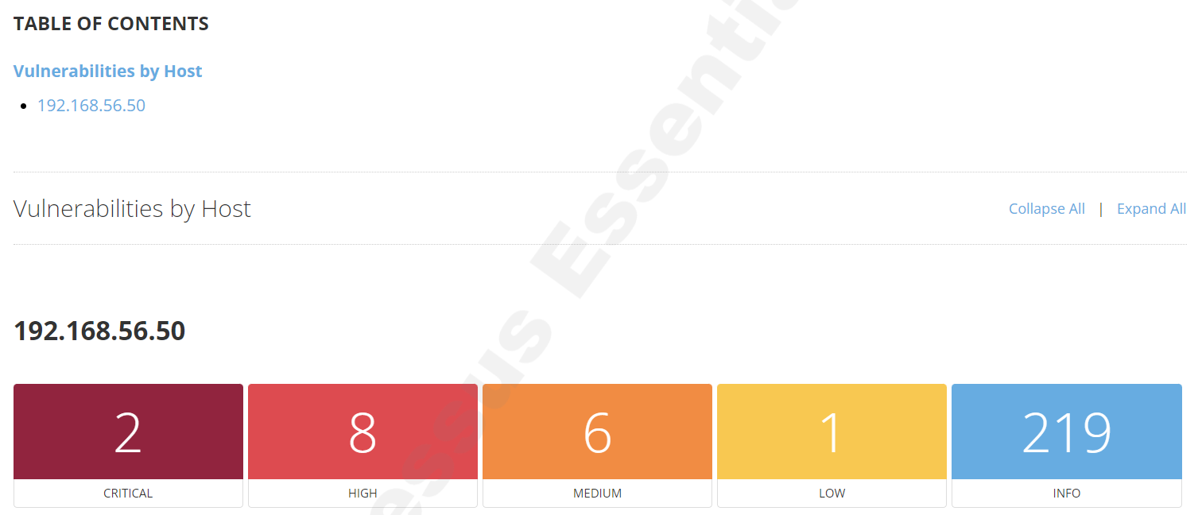

Win2022 Vulnerabilities
Search tools used - Nessus, Nikto, Legion, Nmap
Successful – Nessus

Slide 5
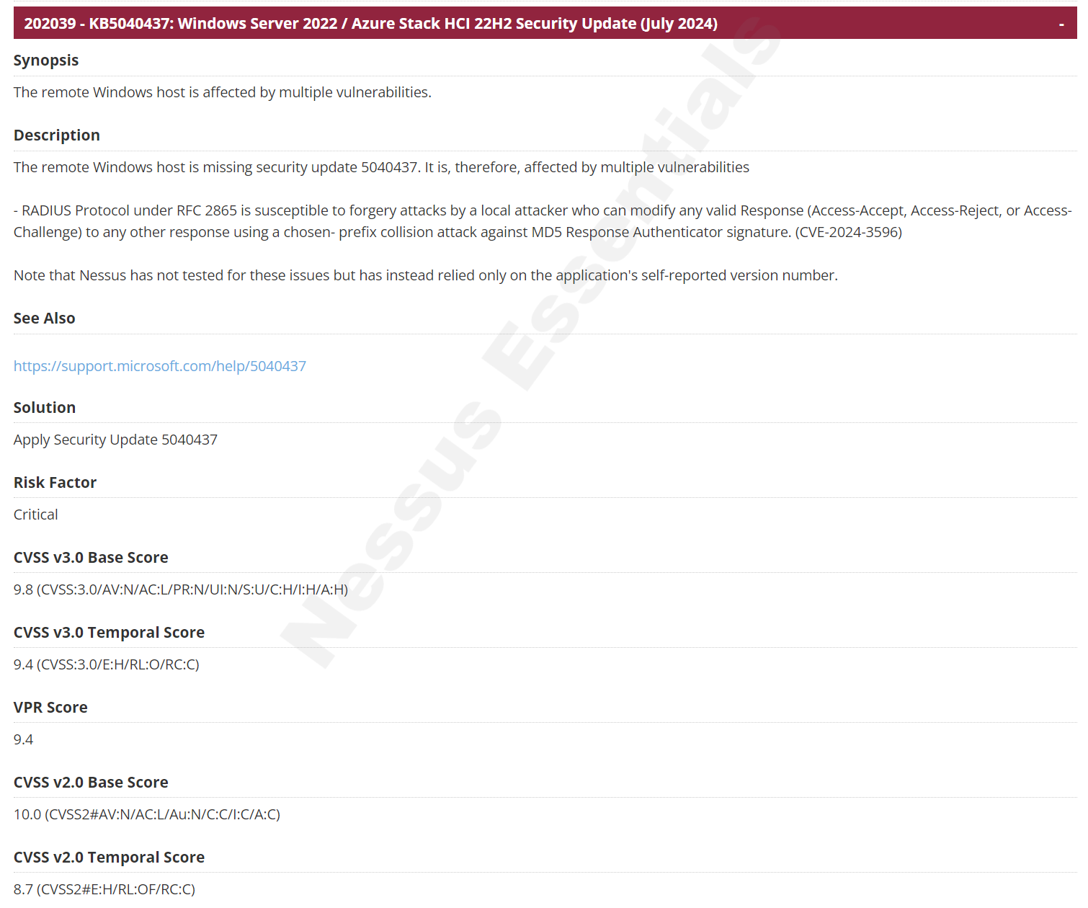

Slide 6
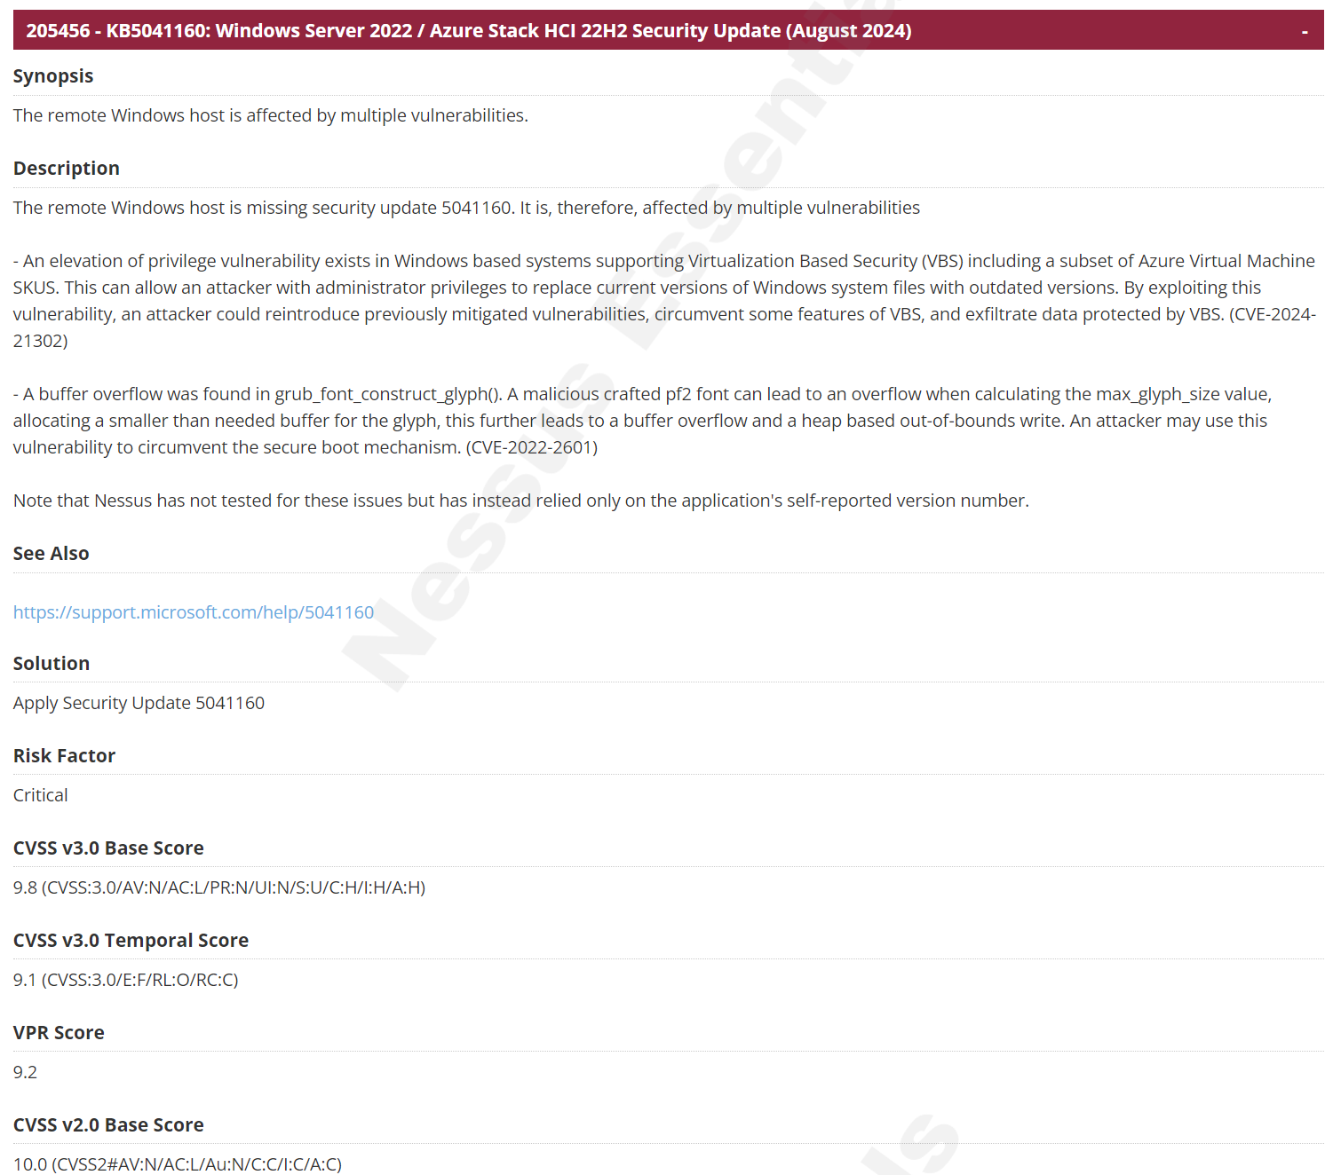

Slide 7
Who is the most likely threat actor?
How do we find this out?

Slide 8

Cyber Threat Intelligence
Motive
Patterns
Techniques

Slide 9

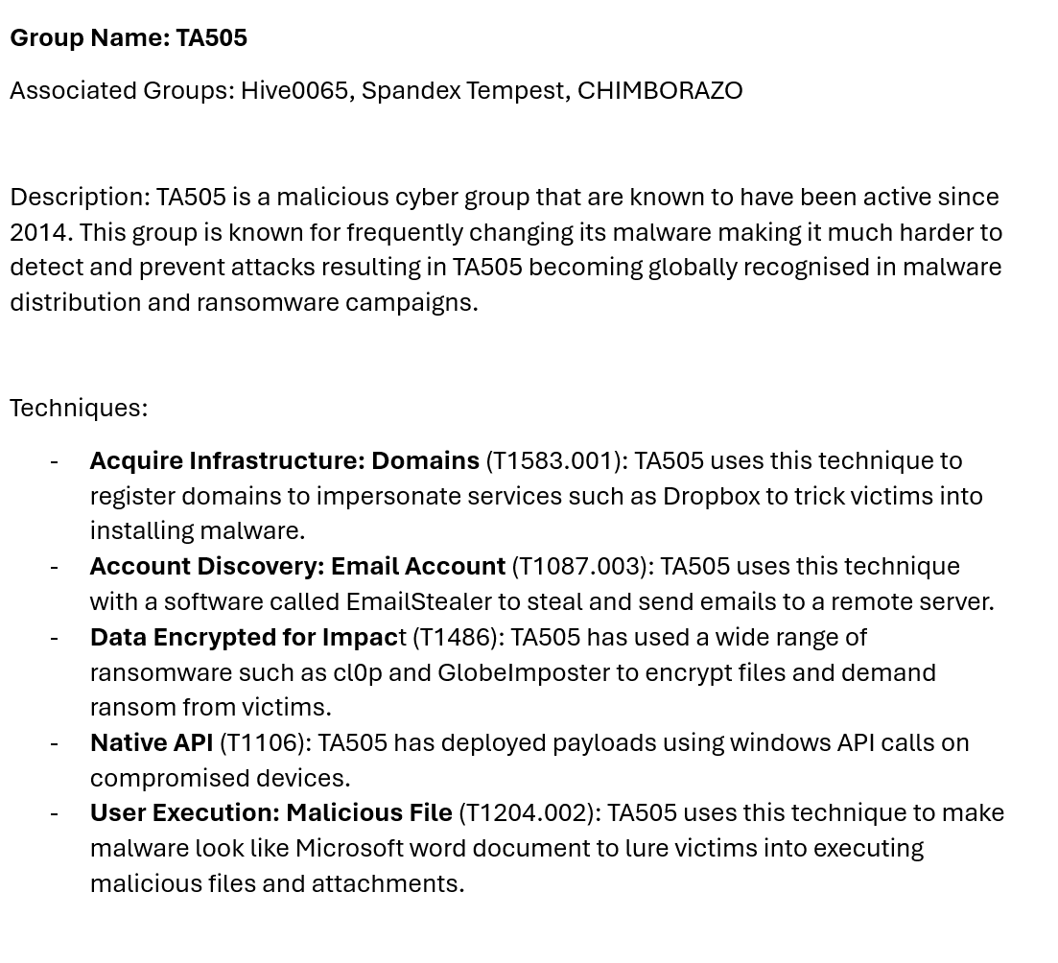
TA505

Slide 10
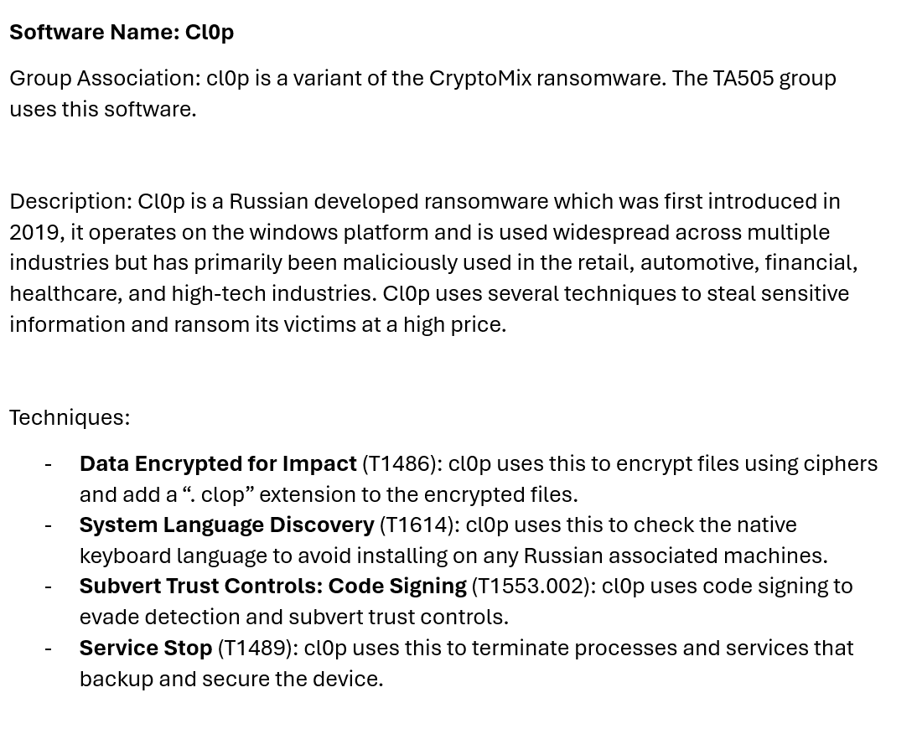
cl0p

Slide 11
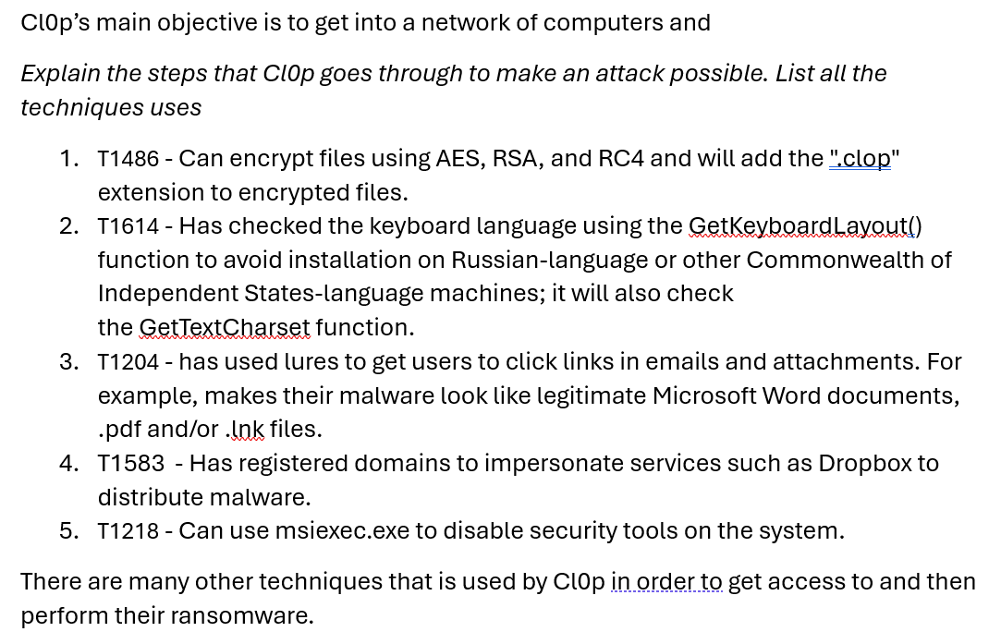
cl0p’s Lifecycle

Slide 12
Threat Actor
We believe that based on the CTI conducted, the most likely Threat Actor is Cl0p due to previously exploiting a zero-day vulrability through MoveIt. This is the CVE https://nvd.nist.gov/vuln/detail/CVE-2023-34362 That then leads to this: CWE-89 https://cwe.mitre.org/data/definitions/89.html
Several sources have been used to match the techniques we have found to several techniques cl0p have previously used.

Slide 13
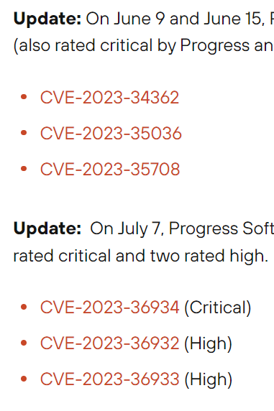
Prioritise Vulnerabilities
Prioritise the vulnerabilities you have found based on their likelihood of exploitation by the Threat Actor within your information system. Choose the three CVEs most likely to be exploited and provide rationales using CAPECs and CWEs. Add three slides to your PowerPoint slides: one slide for each CVE. Each slide should include an analysis table like the following.

Slide 14
Likelihood of CVE exploitation by TA505
As we work at Medisecure, we use the company MoveIt to securely transfer files and help with automation. There are a couple of zero-day vulnerabilities inside MoveIt that the attack likely has come from.
These CVE’s are:
CVE-2023-34362
CVE-2023-35708
CVE-2023-36934.

Slide 15

Emulating an Attack

Slide 16
Technique 1: T1614
Emulating how cl0p would check if the system is Russian, based on the native installed language.
Prevents attacking “one of their own”.
Would be done using the function “GetKeyboardLayout” against the hardcoded values.

Slide 17
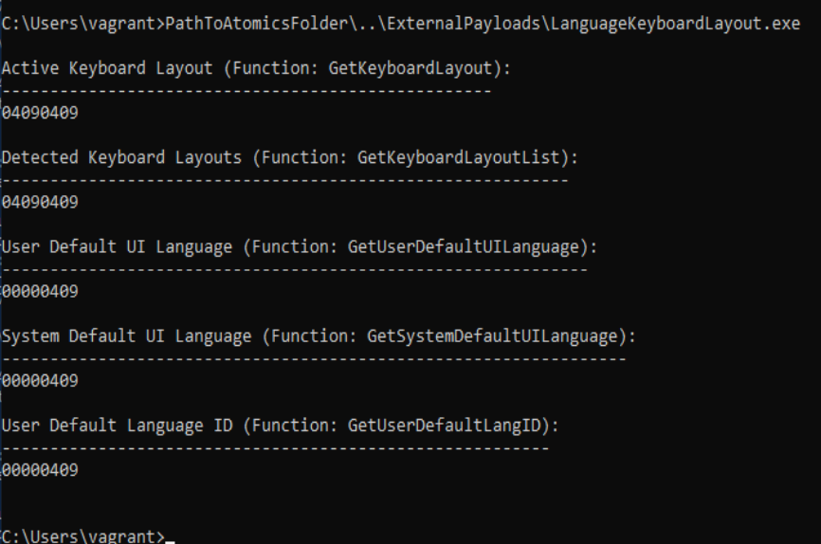
In this example, our system (win2022) shows 0409 which when checked in the OS hex meaning it comes to English - United States. Therefore, if this where to be realistic cl0p would then proceed with the malware attack.

Slide 18
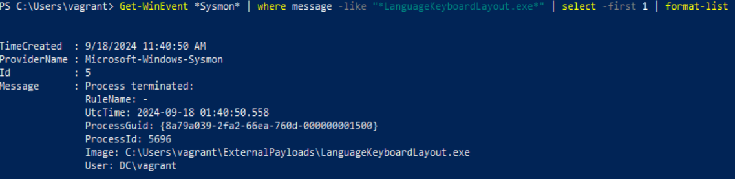
Detection
Sysmon was used in PowerShell to display a list to monitor and log system activity to the Windows event log.
Get-WinEvent *Sysmon* | where message -like "*LanguageKeyboardLayout.exe*" | format-list

Slide 19
Technique 2: T1486
Emulating how cl0p can encrypt files using AES, RSA, and RC4 and will add the ".clop" extension to encrypted files.

Slide 20
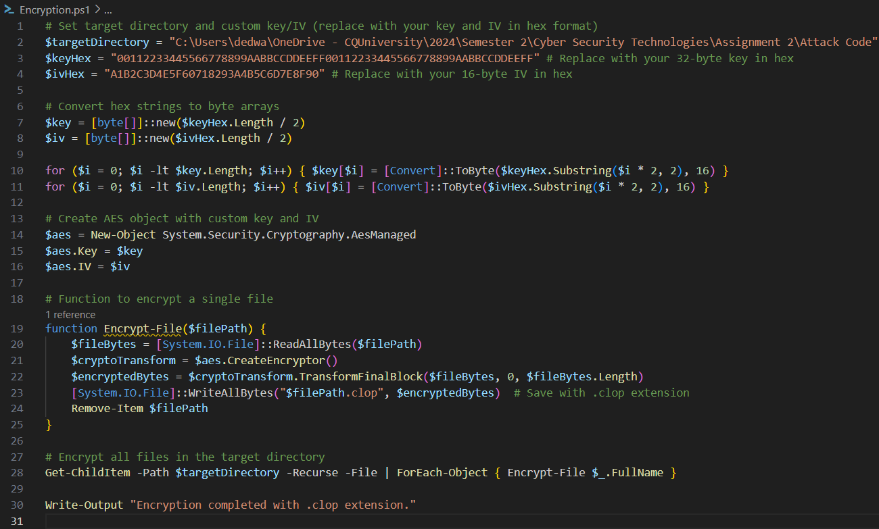
This example shows the process and code involved with encrypting files and creates a new file with .clop extension

Slide 21
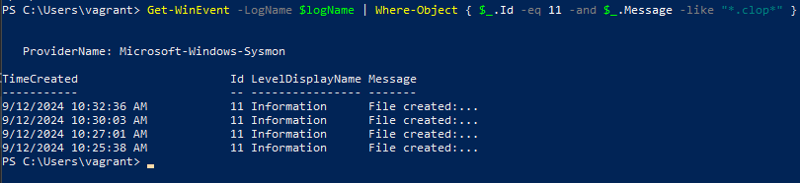
Detection
Sysmon used again to check Event ID 11: FileCreate
File create operations are logged when a file is created or overwritten.
Get-WinEvent -LogName $logName | Where-Object { $_.Id -eq 11 -and $_.Message -like "*.clop*" }

Slide 22
Github Link

Slide 23
References
Cybereason 2023, Cybereason vs. clop ransomware, viewed 17 September 2024, https://www.cybereason.com/blog/research/cybereason-vs.-clop-ransomware
Dark Reading 2023, Cl0p claims moveit attack: how the gang did it, viewed 17 September 2024, https://www.darkreading.com/cyberattacks-data-breaches/cl0p-claims-moveit-attack-how-gang-did-it
National Institute of Standards and Technology (NIST) 2023, Vulnerability summary for cve-2023-34362, viewed 17 September 2024, https://nvd.nist.gov/vuln/detail/CVE-2023-34362
Red Canary Co. 2024, Atomic red team t1486: data encrypted for impact, viewed 17 September 2024, https://github.com/redcanaryco/atomic-red team/blob/master/atomics/T1486/T1486.md
Red Canary Co. 2024, Atomic red team t1614.001: system location discovery, viewed 17 September 2024, https://github.com/redcanaryco/atomic-red-team/blob/master/atomics/T1614.001/T1614.001.md

